Slide 1
Binary Trees
Data Structures Lab-9
Binary Trees.

Slide 2
Today’s Content
What is Binary Tree
Important Concepts
Tree Constraints
Binary Search Trees & Operations on BST
Binary Search Tree Traversing
Lab Task

Slide 3
What is Binary Tree

Slide 4
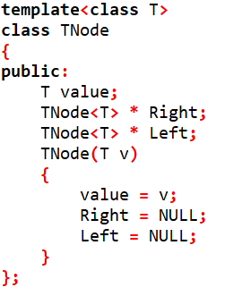
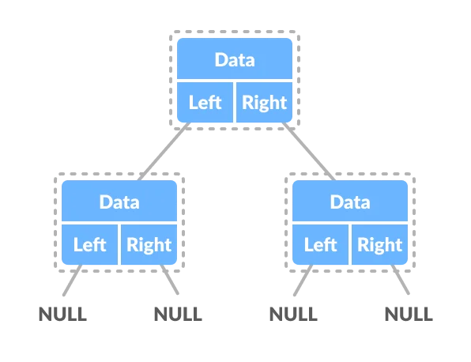

Slide 5
Important Concepts with BT

Slide 6
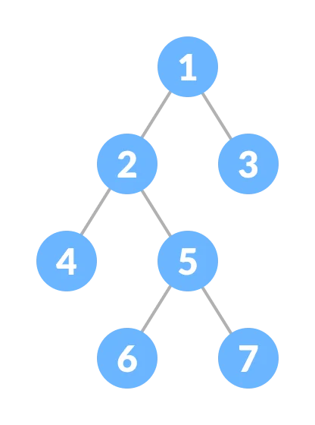
A single element is a node or tree.
First top node is the parent [i.e. 1].
The nodes that we point to are children [i.e. 2, 3].
Nodes that share the same parent are siblings [i.e. 4, 5].
Depth/Level is the # of links from the root. [Depth of 5 = 2, Depth of 7 = 3].
I.e. 6 and 7 are leaves.
Nodes that have children are inner nodes [i.e. 2, 5].
A node without any parents is the root [i.e. 1].
Nodes are organized in levels.
Height(h) = # levels (or #levels -1).
Full tree, every node has two children and leaves are on the same level.
Tree operations are being measured by h.

Slide 7
Important Constraints

Slide 8
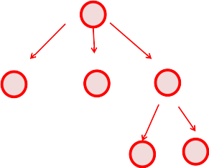
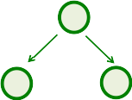

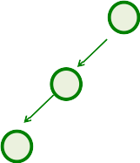
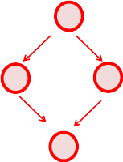


Nodes MUST have only one parent.
No cycles in the tree.
So we have unique path from root to every node.

Slide 9
BST and its Operations

Slide 10
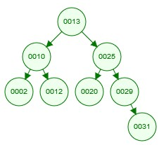
In BST for any node, the left subtree is less than that node, the right subtree is greater than that node.
Less than and Greater than depends on the type of the data.
All nodes in the left subtree are less than the value in the root node.
All nodes in the right subtree are greater than the value in the root node.
The smallest element is the leftmost element.
The largest element is the rightmost element.
BST Operations: [Insert, Delete, Search] Time Complexity = O(h) = O(Log n).
BST Operations are recursive calls per child.
Search for [31] in both the sorted linked list and the binary search tree.
Compare the performance!

Slide 11
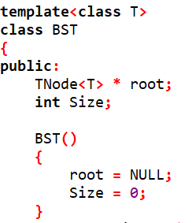
BST class

Slide 12
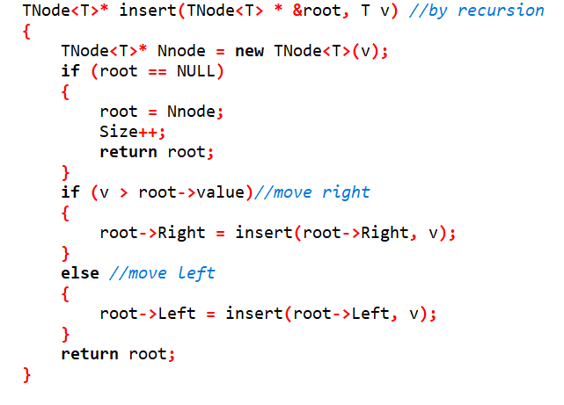
Insertion in BST

Slide 13
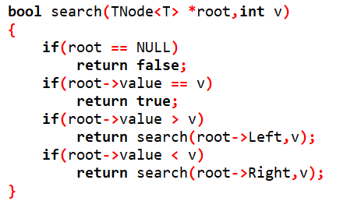
Search in BST

Slide 14
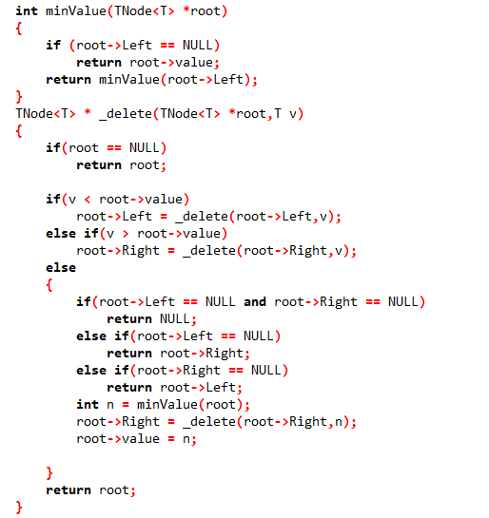
Deletion in BST

Slide 15
BST Traversing

Slide 16
Traversing can be done in two ways:
Breadth-first (Visiting nodes level by level from left to right)
Depth-first
In-order (Left, Head, Right)
Pre-order (Head, Left, Right)
Post-order (Left, Right, Head)

Slide 17
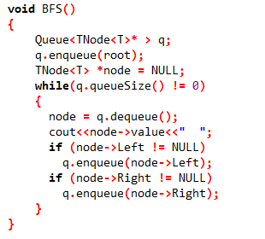

Breadth-First Traversing
Output: 13, 10, 25, 2, 12, 20, 29, 31

Slide 18
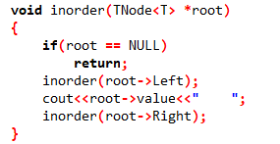
Depth-First Traversing (In-Order)
Output: 2, 10, 12, 13, 20, 25, 29, 31

Slide 19
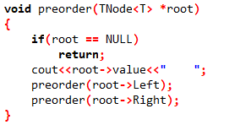
Depth-First Traversing (Pre-Order)
Output: 13, 10, 2, 12, 25, 20, 29, 31

Slide 20
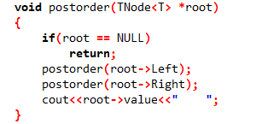
Depth-First Traversing (Post-Order)
Output: 2, 12, 10, 20, 31, 29, 25, 13

Slide 21
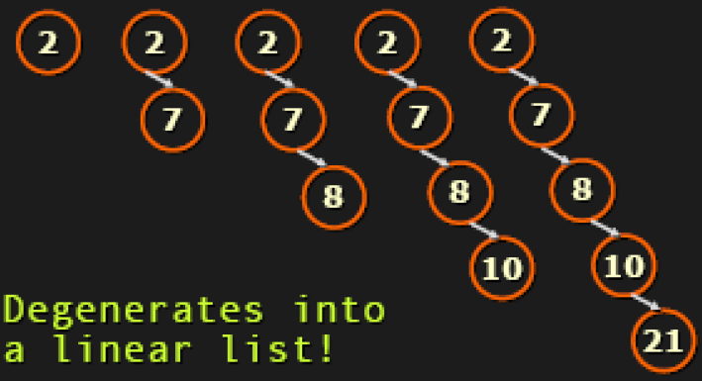
Worst Cases in BST
Insert 2, 7, 8, 10, 21 into an empty tree.
The solution is to keep the BST as much balanced as possible.
Self-Balancing Trees:
Red-Black Trees
AVL Trees
Splay Trees

Slide 22
Lab Task

Slide 23
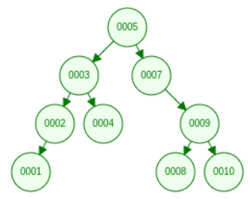
Task is to be delivered on Moodle
Using the In-Order technique, print the nodes within a specific range.
TEST CASE:
printBSTRange(3, 6) => [3, 4, 5]
printBSTRange(8, 15) => [9, 10]
printBSTRange(6, 6) = > []

Slide 24
Thank you!

